Slide 1

Dmytro Maleev for PDC10 Vinnitsa

Slide 2


Forget about CPU frequency increase! There are a lot of issues with this, which will be fixed in future!
1998
Intel 80486
80Mhz
1 Core
2007
Core 2 Duo 2.13 GHz
2 Core
2000
Celeron 400Mhz
1 Core
2010
Intel i5 3.3GHz
2 Core 4 Threads
2003
Athlon XP 1.6+GHz
1 Core
?

Slide 3
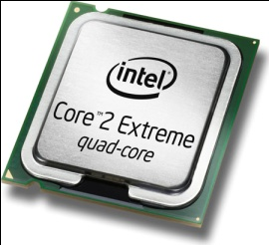

For now…ENLARGE YOUR…
PEN
CPU CORE COUNT!

Slide 4

Parallel Extensions, previously known as the Parallel Framework Extensions or PFX, is a managed concurrency library being developed by a collaboration between Microsoft Research and the CLR team at Microsoft. It is composed of two parts: Parallel LINQ (PLINQ) andTask Parallel Library (TPL).It also consists of a set of coordination data structures (CDS) – sets of data structures used to synchronize and co-ordinate the execution of concurrent tasks.The library was released as a CTP on November 29, 2007 and refreshed again in December 2007 and June 2008. Microsoft has announced that the Parallel Extensions to .NET will release as part of the .NET 4.0 Framework release.
©Wikipedia

Slide 5


Visual Studio Debugging and profiling support
Parallel Extensions
PLINQ
Task Parallel Library
Task Scheduler
CDS

Slide 6

Multithreaded!=parallelization
“ If on a single core machine you are using threads and it makes perfect sense for your scenario, then you are not "doing parallelism", you are just doing multithreading”
”On a single core you can use threads and you can have concurrency, but to achieve
parallelism on a multi-core box you have to identify in your code the exploitable
concurrency: the portions of your code that can truly run at the same time.”
Daniel Moth

Slide 7
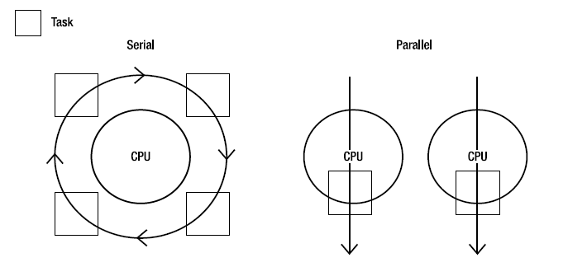

Slide 8


Race conditions
http://en.wikipedia.org/wiki/Race_condition
2. Deadlocks
http://en.wikipedia.org/wiki/Deadlock
http://en.wikipedia.org/wiki/Dining_philosophers_problem
Thread starvation
Difficult to code and debug
Environmental

Slide 9

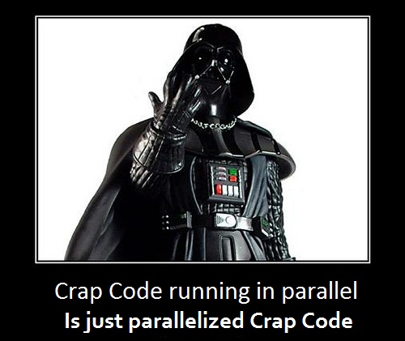

Slide 10

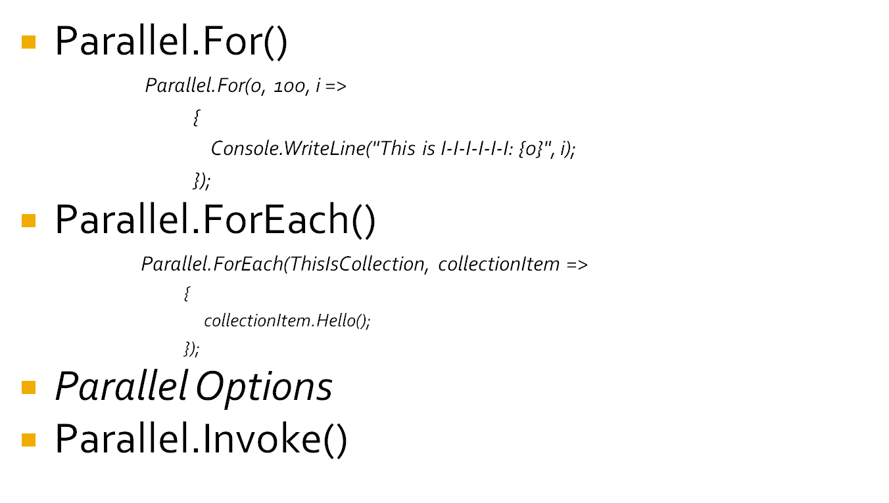

Slide 11


Parallelization Can Hurt Performance☹
http://msdn.microsoft.com/en-us/library/dd560853(VS.100).aspx
http://en.wikipedia.org/wiki/Context_switch

Slide 12


AntiSocial Robots

Slide 13

PLINQ is just parallelized version of LINQ
Not parallelized: LINQ-to-SQL & LINQ-to-Entity.
LINQ:
        var query = from s in someCollection
        let result = CoolService.CallService(s)
        select result;
PLINQ:
        var query = from s in someCollection.AsParallel()
        let result = CoolService.CallService(s)
        select result;

Slide 14

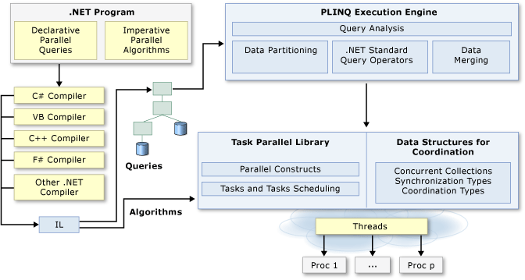

Slide 15

Ordering Results
  AsOrdered()
ForAll Operator()
AsSequential()
WithMergeOptions
Parallel Performance Analyzer. Just for rich☺

Slide 16

Baby Names

Slide 17

?

Slide 18

Mail me:
  diwingless@gmail.com
Skype me:
  hmmidma
Twitter:
  dimko1

